Slide 1
Software Developer Agile Software Development Application Structure and Development Platform Context
Notes:
In this module the apprentice will learn to understand their roles within their software development team.

Slide 2
Components
Please answer the following questions:
What do we mean by:
Code and libraries
Data
Application components
Application interfaces
Notes:
Please research and answer the following questions:
What do we mean by?
Code and libraries
Data
Application components
Application interfaces
OSI (Open Systems Interconnection) model
Instructions:
Work individually or in pairs; your choice
10 minutes

Slide 3



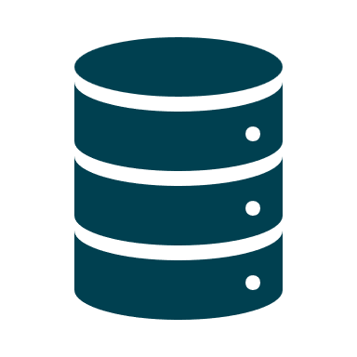
Three-tier architecture
Authentication Module
User Experience and
Session Manager
Internet
Flight / Hotel / Trip
Services
(to search for and book flights, hotels etc.)
Data Access Services
User
Underlying framework
Monolithic Database
Notes:
A three-tier architecture is a client-server architecture in which the functional process logic, data access, computer data storage and user interface are developed and maintained as independent modules on separate platforms. Three-tier architecture is a software design pattern and a well-established software architecture.
The three tiers in a three-tier architecture are:
Presentation Tier: Occupies the top level and displays information related to services available on a website. This tier communicates with other tiers by sending results to the browser and other tiers in the network.
Application Tier: Also called the middle tier, logic tier, business logic or logic tier, this tier is pulled from the presentation tier. It controls application functionality by performing detailed processing.
Data Tier: Houses database servers where information is stored and retrieved. Data in this tier is kept independent of application servers or business logic.

Slide 4
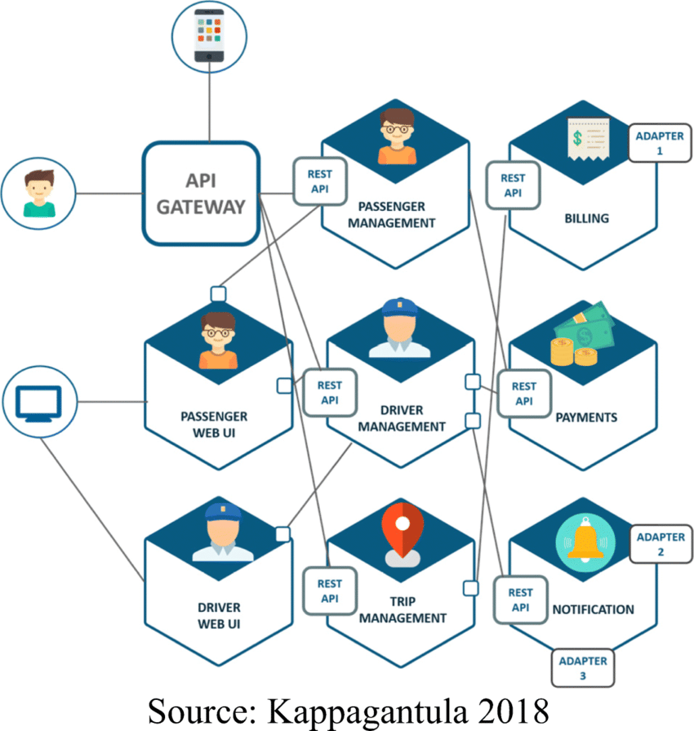
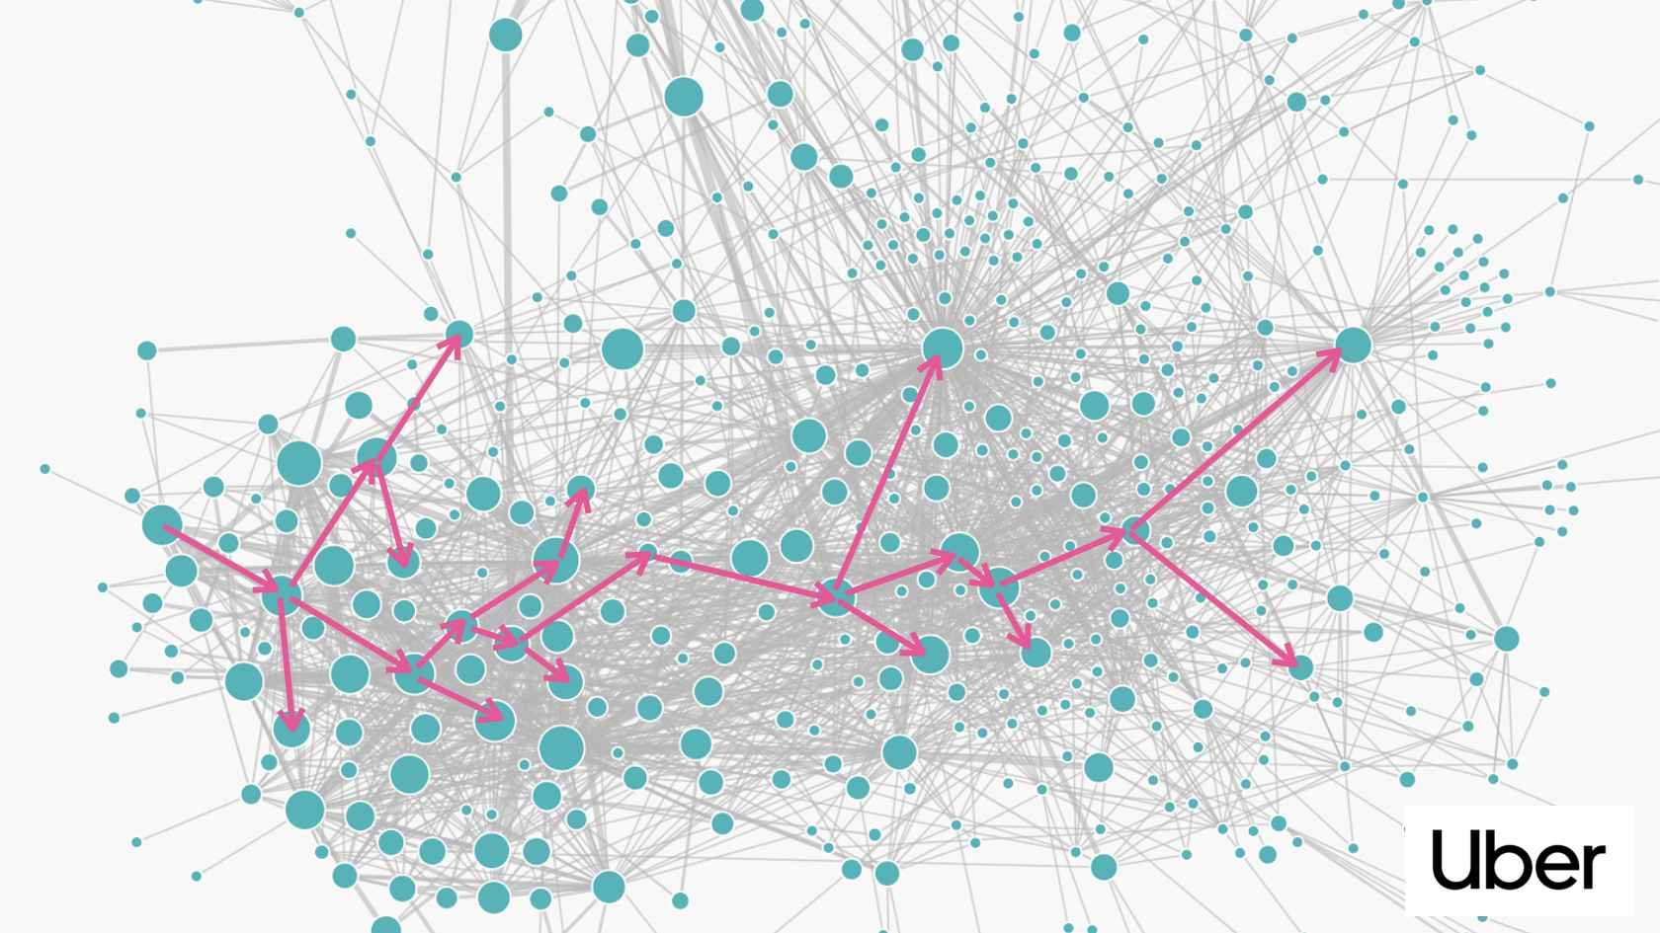
Microservices embody an architectural and organizational strategy for software development, wherein software is crafted from compact, autonomous services that interact through clearly defined APIs. Ownership of these services lies with petite, self-contained teams.
We will not investigate this topic here, but it is worthy of further study
Microservices
Notes:
Source code is any collection of computer instructions, possibly with comments, written using a human-readable programming language, usually as plain text. The source code is often transformed by an assembler or compiler into binary machine code understood by the computer. The machine code might then be stored for execution at a later time. Alternatively, source code may be interpreted and thus immediately executed.
A library is a collection of non-volatile resources used by computer programs, often to develop software. These may include configuration data, documentation, help data, message templates, pre-written code and subroutines, classes, values or type specifications. A library is also a collection of implementations of behaviour, written in terms of a language, that has a well-defined interface by which the behaviour is invoked. Most compiled languages have a standard library although programmers can also create their own custom libraries. Most modern software systems provide libraries that implement the majority of the system services.

Slide 5
Code and Libraries
Code:
Collection of computer instructions – source code.
Readable – usually plain text.
Assembler / compiler transform into machine code:
Execute later
Or interpreted and executed immediately
Libraries:
Collection of resources used to develop software.
Implementation of behaviour with well defined interfaces.
Standard / custom libraries.
Notes:
Source code is any collection of computer instructions, possibly with comments, written using a human-readable programming language, usually as plain text. The source code is often transformed by an assembler or compiler into binary machine code understood by the computer. The machine code might then be stored for execution at a later time. Alternatively, source code may be interpreted and thus immediately executed.
A library is a collection of non-volatile resources used by computer programs, often to develop software. These may include configuration data, documentation, help data, message templates, pre-written code and subroutines, classes, values or type specifications. A library is also a collection of implementations of behaviour, written in terms of a language, that has a well-defined interface by which the behaviour is invoked. Most compiled languages have a standard library although programmers can also create their own custom libraries. Most modern software systems provide libraries that implement the majority of the system services.

Slide 6
Data
Data:
Numbers, characters, strings – other data structures.
Need context to become information.
Metadata – data about data.
Stored on databases / files.
Data structures – Arrays, graphs, objects.
Notes:
Data requires interpretation to become information. To translate data to information, there must be several known factors considered. The factors involved are determined by the creator of the data and the desired information. The term metadata is used to reference the data about the data.
Data representing quantities, characters, or symbols on which operations are performed by a computer are stored and recorded on magnetic, optical, or mechanical recording media, and transmitted in the form of digital electrical signals.
Digital data are often stored in relational databases, like tables or SQL databases, and can generally be represented as abstract key/value pairs.
Data can be organized in many different types of data structures, including arrays, graphs, and objects. Data structures can store data of many different types, including numbers, strings and even other data structures. Data pass in and out of computers via peripheral devices.

Slide 7
Application Components
Application Components:
Separation of concerns / functionality throughout a system.
Reuse based approach – loosely coupled independent components.
Benefits in both the short-term and the long-term for the software / organisation.
Notes:
Component-based software engineering (CBSE), also called as component-based development (CBD), is a branch of software engineering that emphasises the separation of concerns with respect to the wide-ranging functionality available throughout a given software system. It is a reuse-based approach to defining, implementing and composing loosely coupled independent components into systems. This practice aims to bring about an equally wide-ranging degree of benefits in both the short-term and the long-term for the software itself and for organizations that sponsor such software.

Slide 8

Application Interfaces
An interface:
Shared boundary across which components share data
Define interfaces separate from implementation.
Procedures / methods – private variables.
Other modules only interact through interface.
Changes to implementation should not cause interface to fail.
Implementation irrelevant – only concern is the interface.
Notes:
In computing, an interface is a shared boundary across which two or more separate components of a computer system exchange information. The exchange can be between software, computer hardware, peripheral devices, humans and combinations of these.
The interface of a software module A is deliberately defined separately from the implementation of that module. The latter contains the actual code of the procedures and methods described in the interface, as well as other "private" variables, procedures, etc. Another software module B, for example the client to A, that interacts with A is forced to do so only through the published interface. One practical advantage of this arrangement is that replacing the implementation of A by another implementation of the same interface should not cause B to fail—how A internally meets the requirements of the interface is not relevant to B, which is only concerned with the specifications of the interface.

Slide 9

Data sources
Please research and:
List and briefly describe various data sources.
Notes:
Please research and answer the following questions:
List and briefly describe various data sources
Instructions:
Work individually or in pairs; your choice
10 minutes

Slide 10
Databases
Relational:
Organised collection of data.
Schema, tables, queries, views, keys, indexes.
Organise data to model reality to support processes.
NoSQL:
Very fast.
Do not require fixed schema.
Avoid joins by storing denormalised data.
Scale horizontally.

Slide 11
Flat file
Contains records that have no structured interrelationship:
Typically consists of a text file.
From which all word processing or other structure characters or mark-up have been removed.

Slide 12
XML (Extensible Markup Language)
Uses tags to define objects and object attributes
Can be thought of as a text-based database.
Standard way of storing and transferring data between programs and over the internet.
XML
<breakfast_menu>
<food calories="650" >
<name>Belgian Waffles</name>
<price>$5.95</price>
<description>Belgian Waffles</description>
</food>
<food calories="950" >
<name>Homestyle Breakfast</name>
<price>$6.95</price>
<description>Two eggs, bacon or sausage</description>
</food>
</ breakfast_menu>

Slide 13
JSON (JavaScript Object Notation)
Has become more popular than XML
Lightweight data interchange format
Standard for passing data into and out of APIs
JSON
[ {
"CustomerID": "ALFKI",
"ContactName": "Maria Anders",
"ContactTitle": "Sales Representative",
"Address": "Obere Str. 57",
"City": "Berlin",
"PostalCode": "12209",
"Country": "Germany",
"Phone": "030-0074321"
},
{
"CustomerID": "ANATR",
"ContactName": "Ana Trujillo",
"ContactTitle": "Owner",
"Address": "Avda. de la Constitución 2222",
"City": "México D.F.",
"PostalCode": "05021",
"Country": "Mexico",
"Phone": "(5) 555-4729"
}
]

Slide 14

Data Streaming
The transfer of data at a steady high-speed rate:
Sufficient to support such applications.
High-definition television
Continuous backup copying to a storage of data

Slide 15
Platforms
Please research and answer the following questions.
Briefly describe the features of the following development platforms:
Web
Mobile
Desktop
Server
Cloud

Slide 16
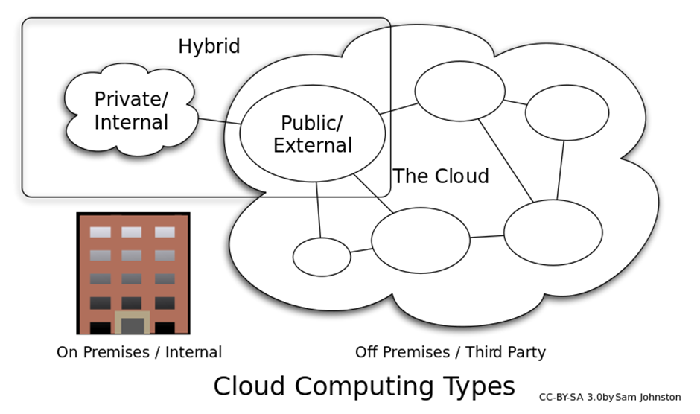
Cloud Platform
Notes:
"The Cloud" is a network of servers. Some servers provide an online service, like Adobe Creative Cloud, and others allow you to store and access data, like Instagram or Dropbox.
Software as a service (SaaS) is the name given to the software licensing and delivery model in which software is licensed on a subscription basis and is centrally hosted. It is sometimes referred to as "on-demand software“.
Other cloud services are:
Infrastructure as a Service (IaaS)
Platform as a Service (PaaS)
Desktop as a Service (DaaS)
Managed software as a service (MSaaS)
Mobile backend as a service (MBaaS)
Information technology management as a service (ITMaaS)

Slide 17
Deployment
Discuss:
Why might it be more difficult to develop an application for multiple platforms verses a single platform?
Notes:
Please research and answer the following questions:
What characteristics of software development are impacted by the deployment of software to:
Multiple platforms
A single platform
Instructions:
Work individually or in pairs; your choice
10 minutes

Slide 18
Challenges with multiple platforms
Testing
More complicated: each platform has different behaviours or subtle bugs
Development
Use lowest common denominator subset
Hinder performance, different user interface
Scripting languages
Translate into native executable code each time application executed
Cross-platform security flaws
Need to support multiple versions
Configuration management / version control
More complex
Maintenance
Security
Notes:
Testing cross-platform applications may be considerably more complicated, since different platforms can exhibit slightly different behaviours or subtle bugs.
Developers are often restricted to using the lowest common denominator subset of features which are available on all platforms. This may hinder the application's performance or prohibit developers from using platforms’ most advanced features.
Different platforms often have different user interface conventions, which cross-platform applications do not always accommodate.
Scripting languages and virtual machines must be translated into native executable code each time the application is executed, imposing a performance penalty. This penalty can be alleviated using advanced techniques like just-in-time compilation; but even using such techniques, some computational overhead may be unavoidable.
Cross-platform execution environments may suffer cross-platform security flaws.
Ongoing maintenance and support will be more complex as will the necessary Configuration Management and Version Control to co-ordinate and the code variations.

Slide 19
review
Notes:
The final section is a review of module, specifically the Learning Outcomes and Assessment Criteria, with a quick quiz and a chance to ask any further questions and provide brief feedback.

Slide 20
Questions and feedback

